Slide 1
PROject PRESENTATION
“BILIRUBIN LEVEL DETECTION OF NEONATAL JAUNDICE USING COLOUR SENSOR IN PHOTOTHERAPY”

Slide 2
OUTLINE OF PRESENTATION
Introduction
Review of Previous work
Methodology
Results and Discussions
Conclusion

Slide 3
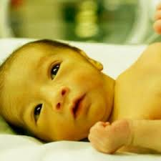
introduction
Jaundice is a condition of yellowish discolouration of the skin and the conjunctiva of the eye.
The condition is common in neonates than adults.
Types of Neonatal Jaundice
Physiological jaundice ( less severe)
Pathological jaundice ( most dangerous)
Pathological jaundice is treated by phototherapy

Slide 4
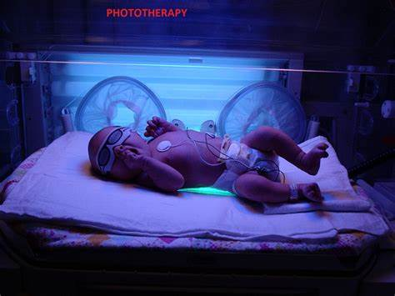
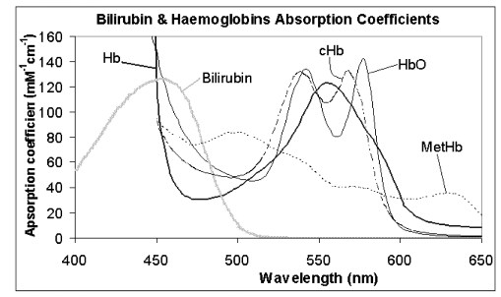
Concept of phototherapy
Used when serum-bilirubin level rises above 5mg/dl
Blue Light + bilirubin = water soluble isomers

Slide 5
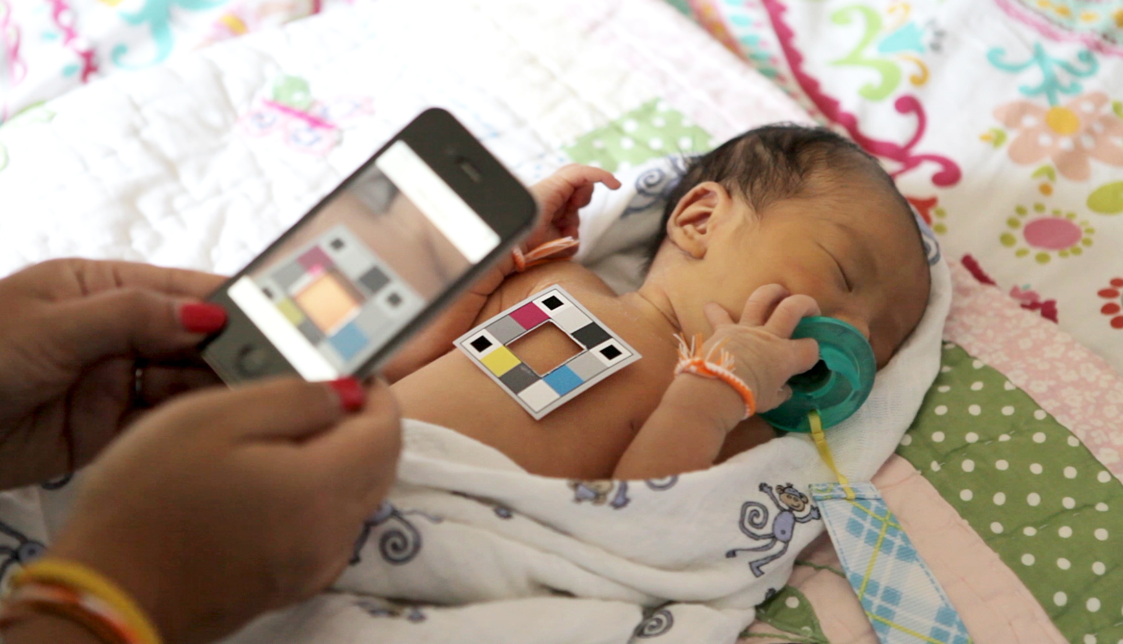
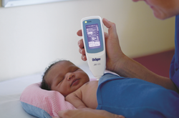
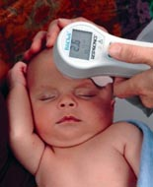
Review of previous works
The Bilicam Android app
Internet connection needed, color calibration card needed, less sensitive to low level bilirubin.
Transcutaneous Bilirubinometer
Device is costly (3500-4295 USD), Calibration tip disposed.

Slide 6
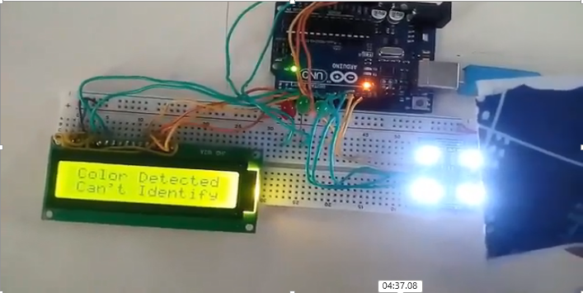
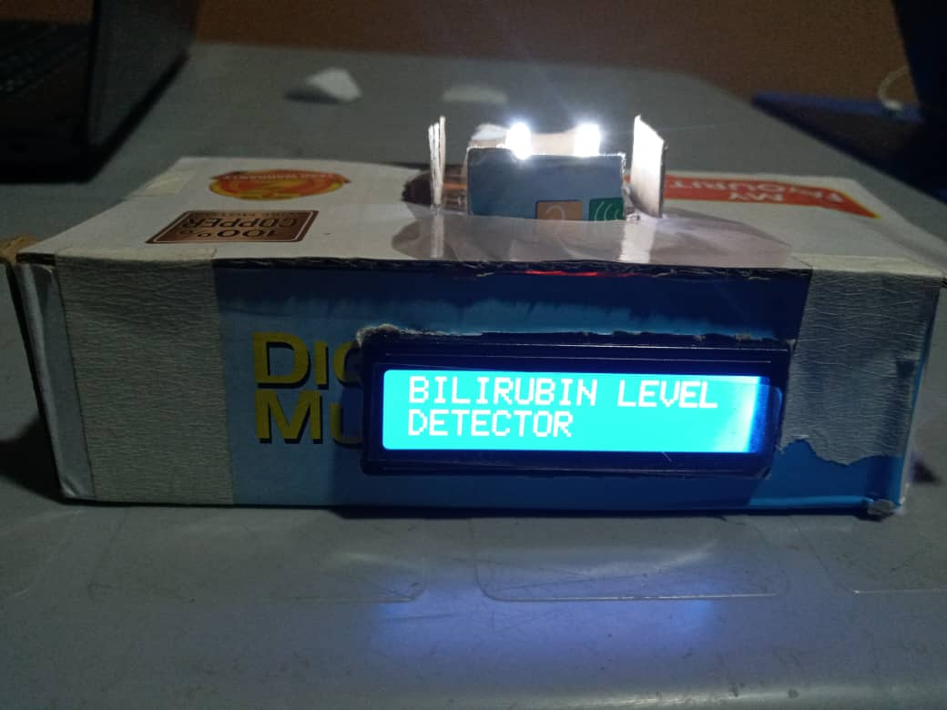
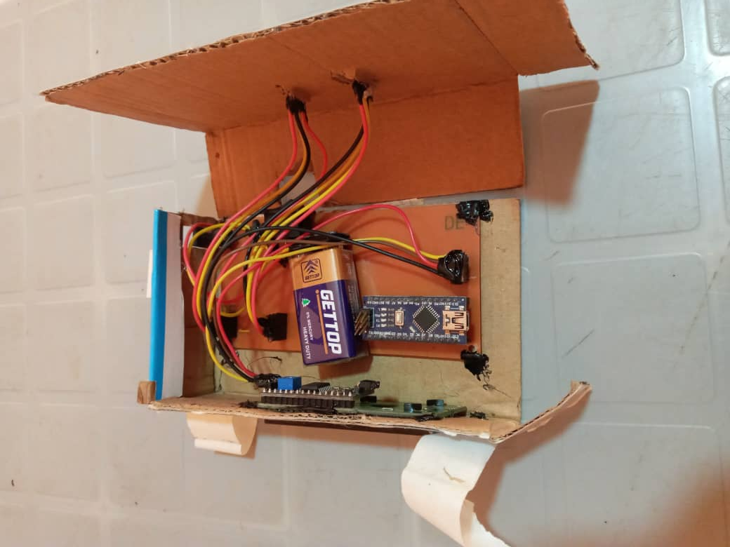
Proposed solution and final solution

Slide 7
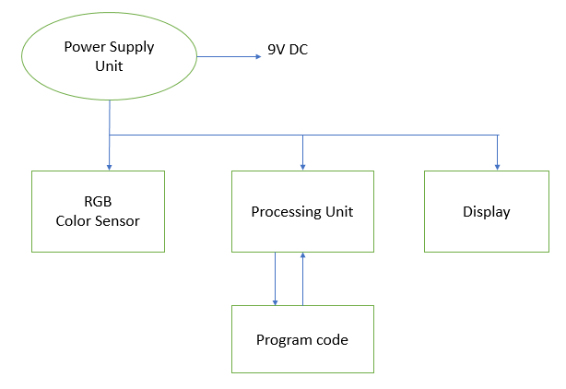
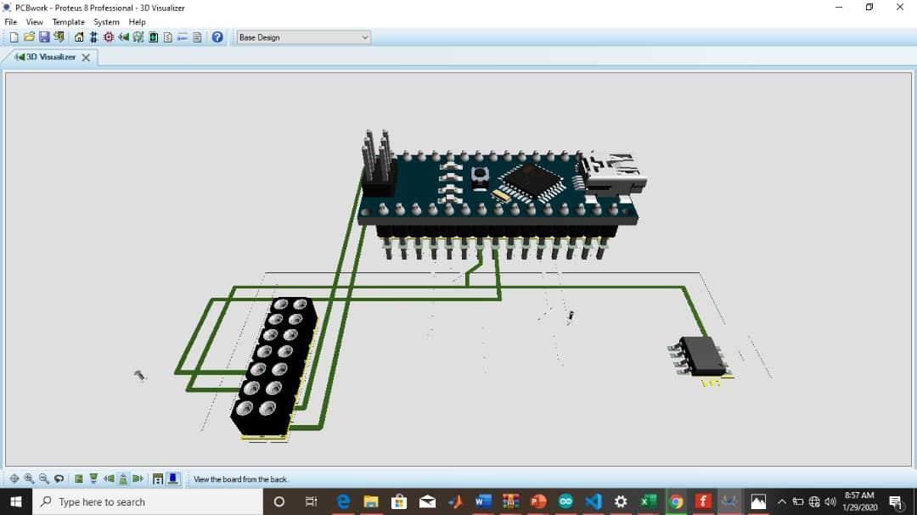
methodology

Slide 8
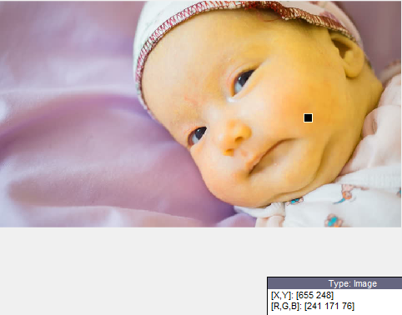
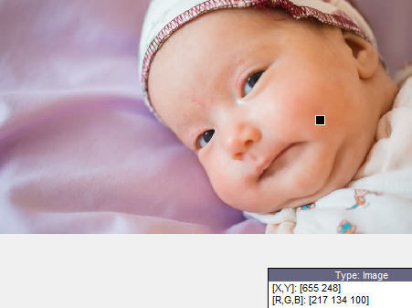
methodology
After Time (T) of Phototherapy | RGB values (from MATLAB) | Normalized % of Blue | TSB value (mg/dl) (From Lab test) | Jaundice State
T₀ | [241, 171, 76] | 15.57% | 13.84 | Severe
T₁ | [217,134,100] | 22.17% | 8.70 | Mild

Slide 9
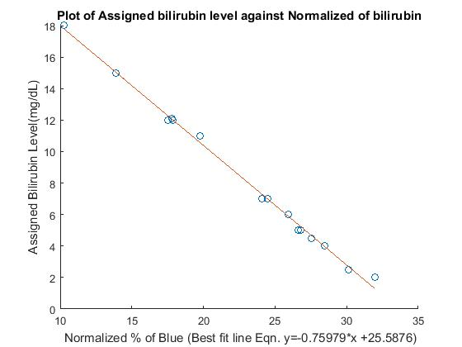
methodology
NEONATE | RGB VALUES | NORMALIZED BLUE % | ASSIGNED Bilirubin Level | STATE OF JAUNDICE
I | [162,87,29] | 10.24 | 17.99 | Severe
II | [224,181,147] | 26.63 | 5.23 | Mild
III | [194,126,79] | 19.79 | 10.55 | Severe
IV | [170,124,64] | 17.87 | 12.04 | Severe
V | [195,135,107] | 24.48 | 6.90 | Mild
VI | [183,102,46] | 13.89 | 15.15 | Severe
VII | [231,205,188] | 30.12 | 2.50 | Normal
VIII | [173,119,107] | 26.81 | 5.09 | Mild
IX | [234,157,137] | 25.94 | 5.76 | Mild
X | [155,108,100] | 27.54 | 4.51 | Mild
XI | [137,94,49] | 17.5 | 12.33 | Severe
XII | [91,57,47] | 24.10 | 7.19 | Mild
XIII | [196,127,70] | 17.81 | 12.09 | Severe
XIV | [107,109,86] | 28.47 | 3.79 | Normal
XV | [192,153,162] | 31.95 | 1.08 | Normal

Slide 10
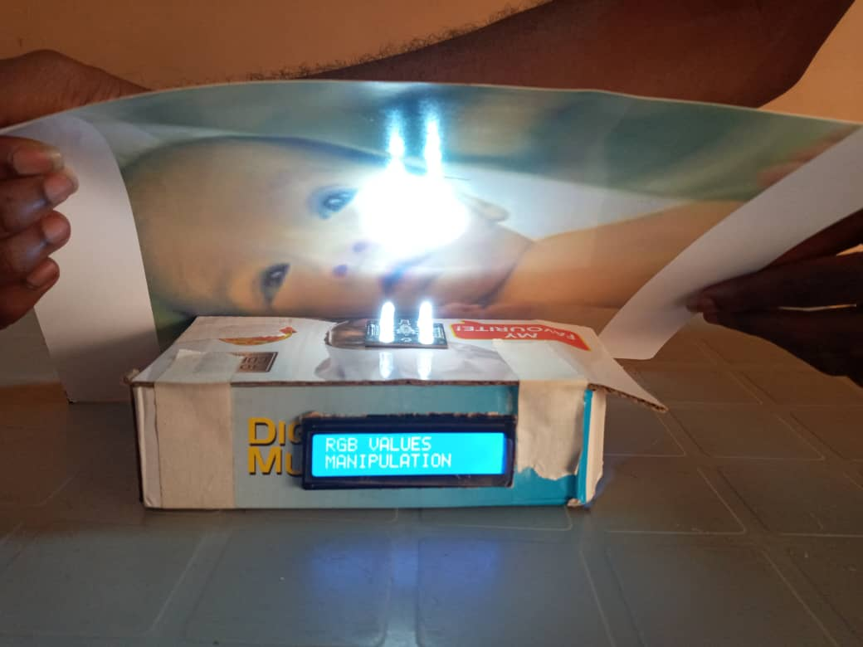
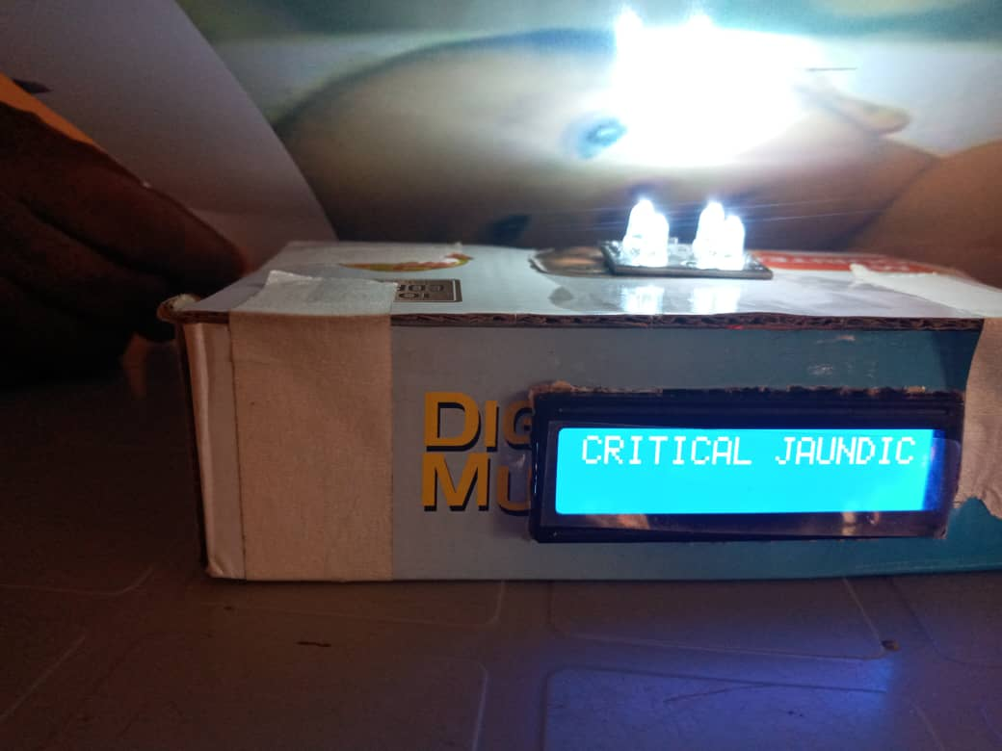
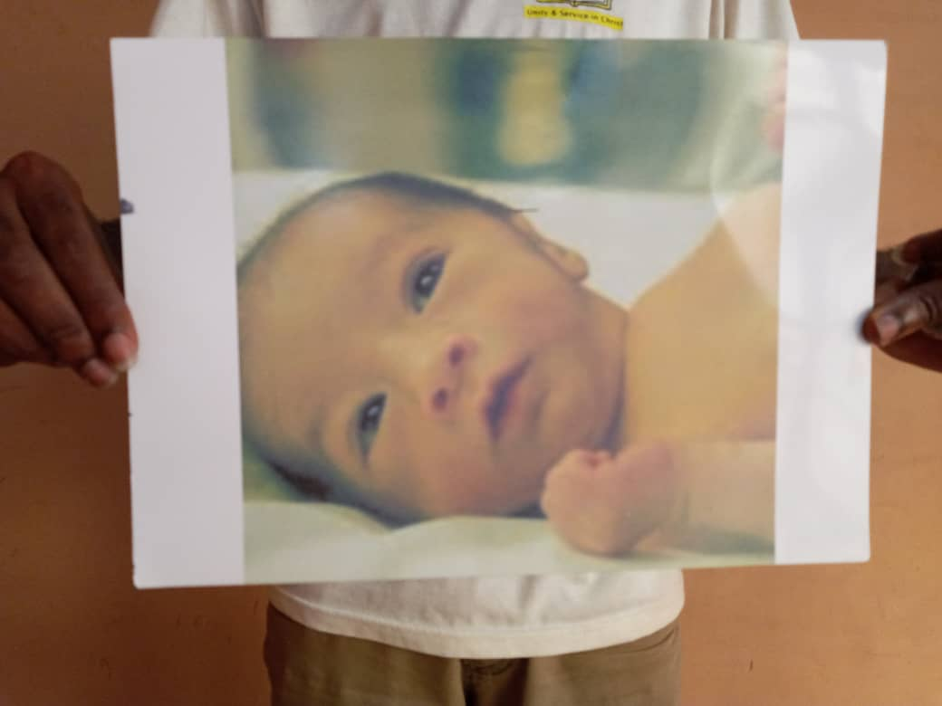
results and discussion
The results shows that the jaundice condition of the neonate above is critical.

Slide 11
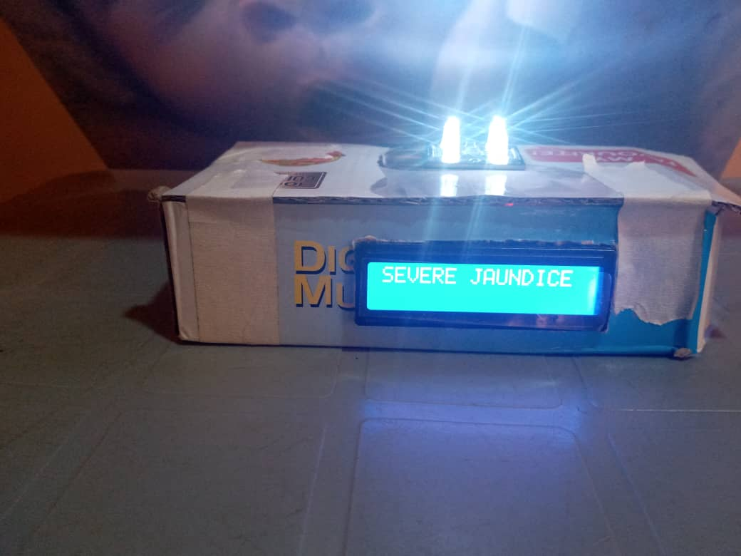
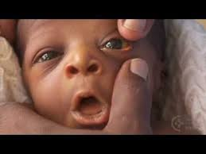
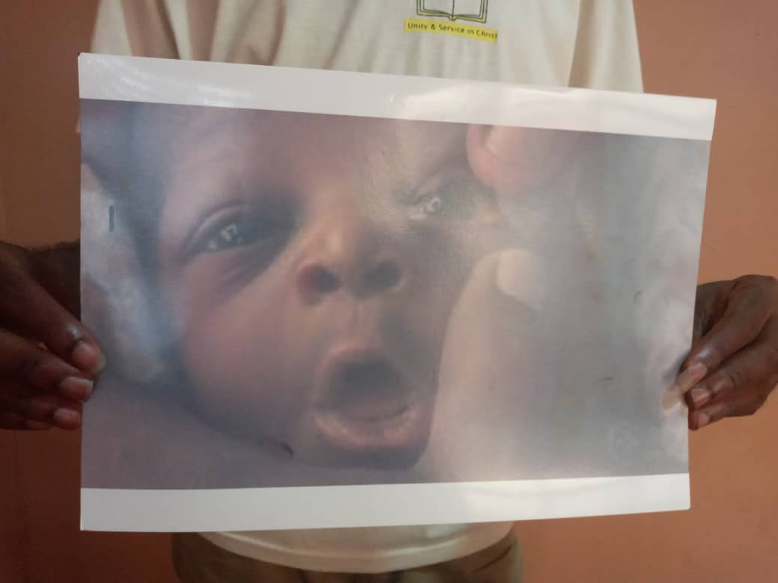
results and discussion
From the results it shows that the neonate has severe jaundice

Slide 12
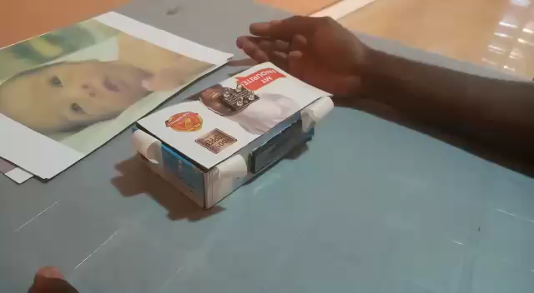
Demonstration OF DEVICE

Slide 13
CONCLUSION
Although the device functions effectively in enhancing jaundice diagnostic time and also in ascertaining the state of jaundice, however real life data was unavailable to be used for the device configuration due to the covid-19 pandemic.
Actual data analysis with TSB values and real life subjects (neonates) is thus recommended for the device configuration.
THANK YOU

